Slide 1


SOS
Created By: K.O.D

Slide 2
SOS Overview
SOS is a gaming application that allows persons to compete against each other to see who can get the most “SOS” before all the slots are filled up.

Slide 3

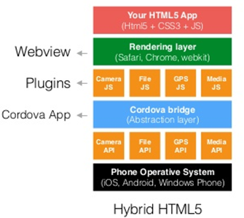
System structure

Slide 4

Requirements and Configuration
Android OS
Minimum recommended android version: 4.4 (kitkat)

Slide 5
Which architecture was chosen?
S O S

Slide 6
MvC model
Reasons for choosing this model:
Three distinct layers
Faster development process
Modification does not affect entire program

Slide 7
Model layer
Database Features
The database consists of two arrays
Records consists of two key-value pairs (player name and score)

Slide 8
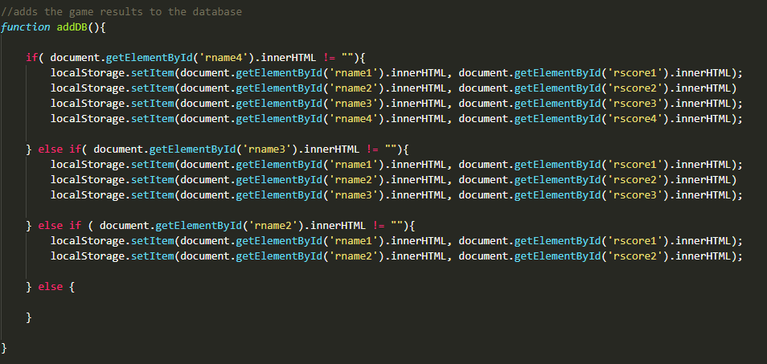
Adding results to the database
S O S

Slide 9
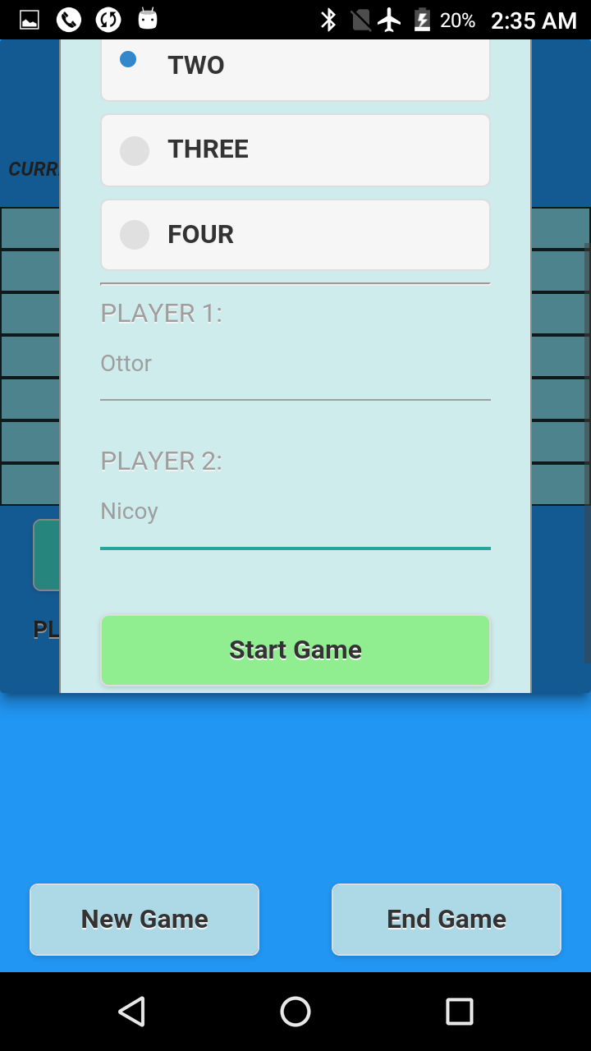
view layered
Textbox
Buttons
Text view
Image view
Alert dialog
Animation
Modal dialog

Slide 10
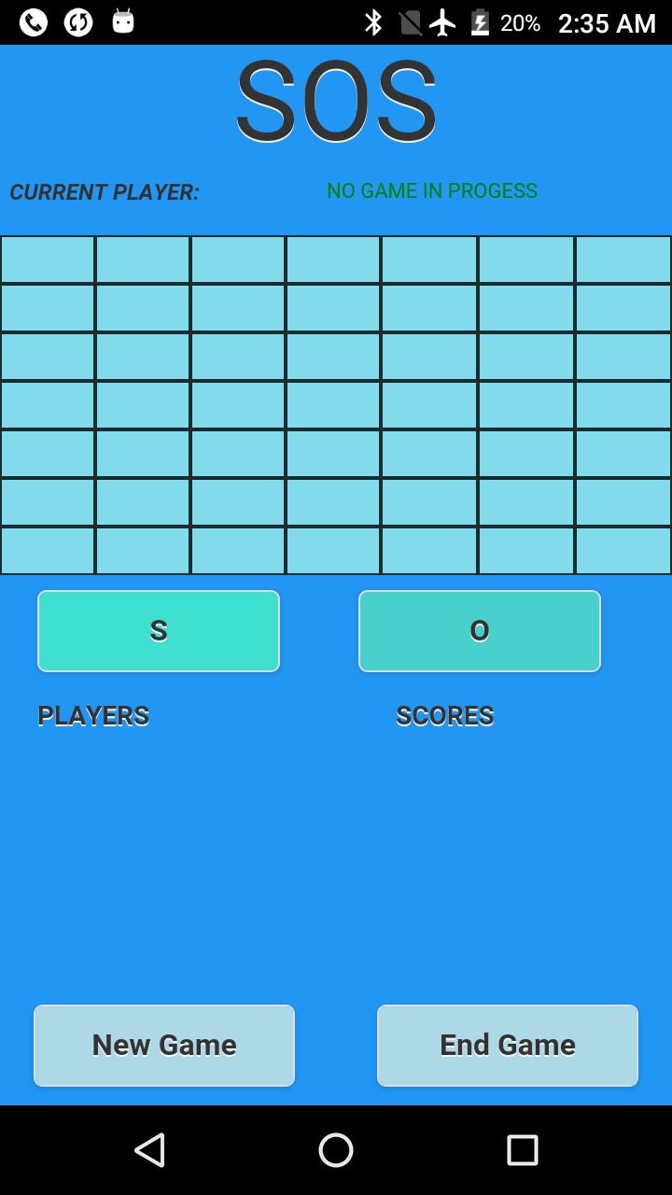
Buttons
S O S

Slide 11
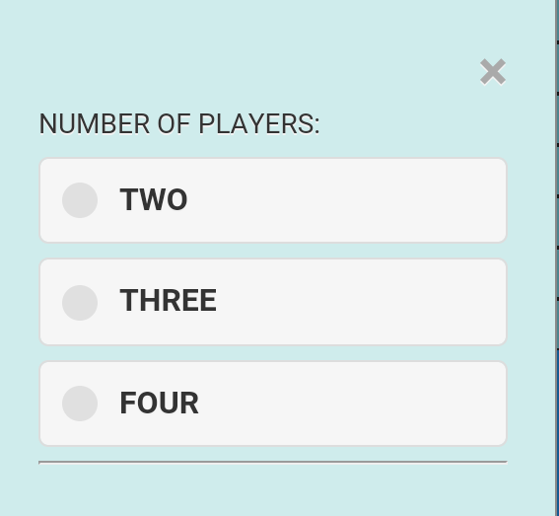
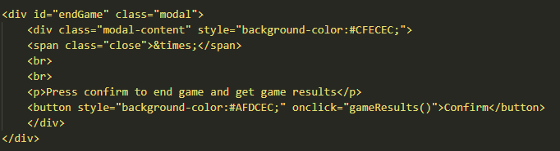
Modal dialog
S O S

Slide 12
Controller layer
Functions of the Control Layer:
Next( )
setPosition( )
detectTrio( )
S O S

Slide 13
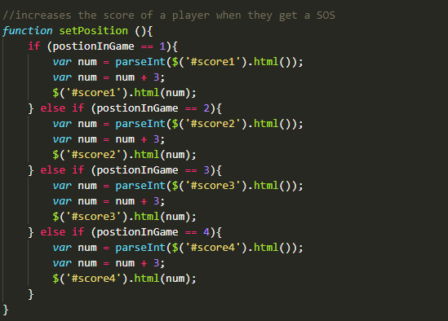
Set position function
S O S

Slide 14
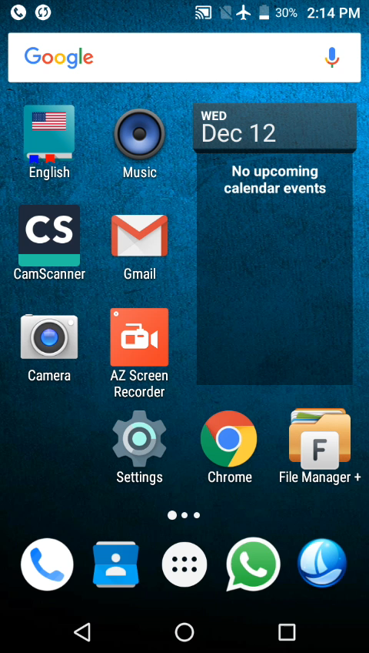
S O S

Slide 15
Thank you
KOD inc

